Slide 1

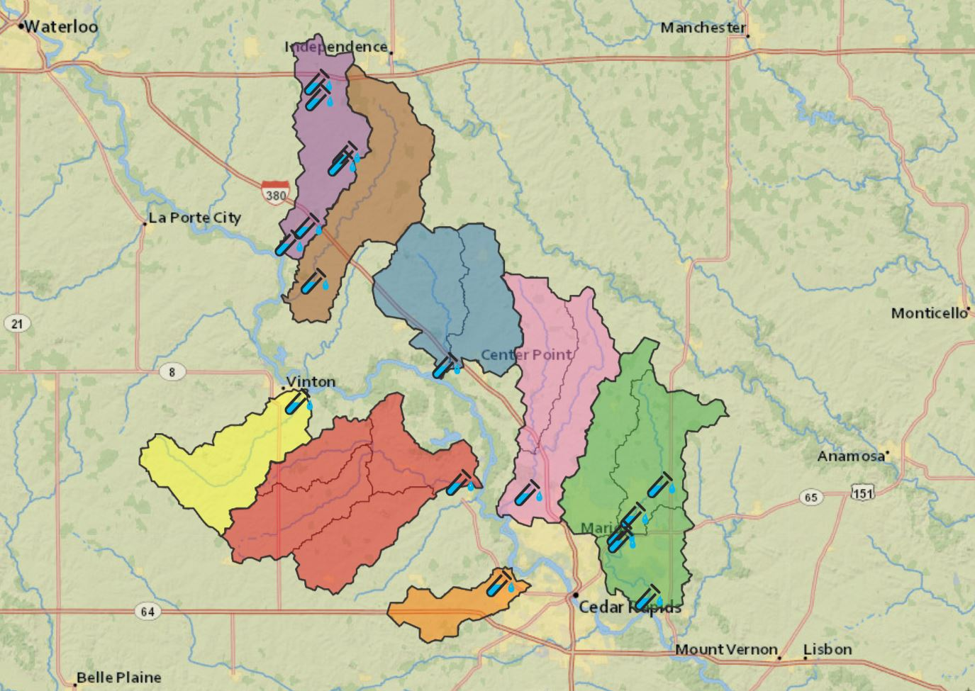
Creating an R Shiny Dashboard to Visualize the Composition and Quality of Cedar River Watersheds.
Project Overview
About the Data
Scan this QR Code to see the Dashboard
Professor Martin St. Clair, a professor of chemistry at Coe College, has been collecting water samples from watersheds along the Cedar River since 2002. We have created a live dashboard which includes interactive maps and visualizations of this data.
Nitrate is of particular interest to us in these watersheds. Nitrate is commonly found in water across Iowa as rain washes nitrogen fertilizer into nearby creeks and streams. Nitrate washes into these watersheds, which then drain into the Cedar River. Cities like Cedar Rapids, which gets its drinking water from shallow wells along the cedar river, are especially susceptible to having their drinking water contaminated.
The dataset of water samples includes different chemical concentrations in the water as well as a few other variables related to water quality. The variables are listed below.
Historical rainfall estimates and geographical data for the watersheds were also used.
Dissolved Oxygen | Water Temperature | pH | Conductivity
Turbidity | Total Suspended Solids | Dissolved Reactive Phosphorus | Chloride
Nitrate | Sulfate | E. coli
Water Quality Index
In this dashboard we include a page about a water quality index. We use a metric proposed by Chris Jones, an IIHR Engineer at the University of Iowa. The water quality index takes five factors into consideration: Dissolved Oxygen, E. coli, Total Nitrogen, Total Phosphorus, and Turbidity. Using these five factors we can calculate a number between 0 and 100 to describe the health of a watershed.
This water quality index can be used to compare the health of a watershed over the years, or to compare the health of two different watersheds.
Must be connected to campus internet
Sources
Nitrate Nitrogen in Surface Waters as Influenced by Climatic Conditions and Agricultural Practices by Gyles W. Randall* and David J. Mulla
The Relationship of Nitrate Concentrations in Streams to Row Crop Land Use in Iowa by Keith E. Schilling* and Robert D. Libra
Cedar River Tributary Study Summer 2021 by Dr. Martin St. Clair
Iowa Rivers 1 to 45: The Fair, the Marginal, & the Ugly by Chris Jones
Iowa State University IEM Rainfall

